Slide 1

APIs for Regulators
Some ideas from Australia
Steve Capell
steve.capell@gmail.com

Slide 2
Regulators care about two things
Compliance (mostly about imports)
Maximising treasury coffers by avoiding duty & GST revenue leakage
Maximising border security by Intercepting illicit cargo
Facilitation (mostly about exports)
Maximising balance of trade by facilitating exports.
Maximising national efficiency by streamlining imports.
Lets take a look at how APIs and Identity frameworks are changing the regulatory model.

Slide 3
Single windows will become APIs
Facilitation
Today’s reality
99% of all high volume regulatory transactions in AU are lodged by machines via EDIFACT. Only 1% by humans via portals. Lesson – nobody wants to use portals.
Even if AU govt had a single web portal for all import/export processes, it would only cover a small part of a consignment lifecycle. Lesson – no window can be single.
All government Agencies have API implementation projects.
Therefore the strategy is to allow any system to easily integrate via a suite of consistent APIs.
I use my
Integrated System
This is the real “single window”!
Trader / regulator / intermediary
Reports, declarations, permits, certificates, etc
Manifests, transport events, invoices, certificates, etc
APIs
API
API
API
API
API
API
APIs
Aligned with
Aligned with

Slide 4
Just give us the data and we’ll tell you your obligations
Compliance
In almost all cases today, the regulated party makes a self assessment and reports the outcome to government.
“I’ve done all my bookkeeping and here’s how much tax I think my customer owes you”. This is a typical tax return from an accountant.
”I’ve looked at the commercial documents, figured out the tariff codes and here’s how much duty I think my customer owes you”. This is a typical import declaration lodged by a customs agent.
The regulator only sees the self-assessed outcome and not the raw data. And from that very limited data, has to figure out whether to audit accounts or withhold cargo.
A better model is emerging.
“Give my all your employee payslips and I’ll tell you how much tax to pay.” This is happening now in AU via the ATO’s “single touch payroll” program.
”Give me the waybill and commercial invoice and I’ll figure out your duty and permit obligations”. This is not yet happening in AU but is perfectly feasible so I’m guessing ABF is seriously thinking about it.
And APIs are how the data would be provided. It also means that customs authorities will become more interested in commercial data standards such as those from UN?CEFACT.

Slide 5
Identity as a service
Facilitation
Compliance
All governments know how to identify their citizens and businesses
For citizens they have strong identity verification processes as part of passport / drivers license / medicare card etc issuing processes. In AU these have been linked to an online identity called myGov for many years.
For businesses and companies they are the registration authority and so are the source of truth about the identity and status of every business. In AU businesses have been linked to an online identity called AusKey for many years.
However both myGov and AusKey are only used for citizens and businesses to authenticate to government services. That leaves a huge opportunity on the table.
The new AU government GovPass program integrates and federates earlier identity schemes and delivers an OIDC Identity provider API. The next step is to allow non government relying parties so that commercial platforms can trust the identity of their users because they have “signed on with GovPass”
GovPass
Remember token claims?
Get token
AU government asserts that the token bearer is ACME Pty Ltd, ABN 12345
API consumer
Present token
verify token
Now that is a useful and trustworthy claim!
API provider
“Relying Party”

Slide 6
Inter-Government Cooperation
Facilitation
Compliance
Governments are increasingly co-operating
Free Trade Agreements.
Trusted trader mutual recognition arrangements.
Secure trade lanes (export/import compliance data sharing).
But there’s still a lot of paper involved (certificates etc) because there’s no common protocol for exchange and no way for importing regulator to verify identity of issuer in the exporting jurisdiction.
The AU government is testing the “inter-government ledger” (another UN/CEFACT project) as a means to digitise all cross border regulatory documents. IGL is a suite of standard APIs.
Export
Ship
Import
National Single Window
G2G Pipelines
National Single Window
Inter-govt Ledger
API
API
API
API
API
API
Carriers
Seller
3PL
Agent
Buyer
National Identity Platform
Commercial Data Pipelines
National Identity Platform
e.g. GovPass
e.g. TradeLens

Slide 7
Facilitation – CoO example
Facilitation
Complex multi step process for preferential certificates of origin.
The Paper Process
Chamber
H A
GAC
HELP!
From
Paper Certificate
Exporter
Agent
Forwarder
Importer
Trusted digital exchange with real time verification by all parties
The Digital Process
Easy!
Chamber
H A
GAC
To
Digital Certificate
Exporter
Agent
Forwarder
Importer

Slide 8
Compliance – Import Dec example
Compliance
From
??
What’s really in the box and who packed it?
Risk decisions based on minimal information from poorly identified parties. High risk of revenue leakage.
Exporter
Importer
Agent
Customs
?
?
?
?
tampering
Obfuscation
Invoice
invoice
Entry
To
I’ve pre-cleared your shipment and calculated duty : you owe $550
Risk decisions based on strong identity and detailed shipment data. Much lower revenue leakage.
Customs
Invoice
Customs
Declaration
Exporter
Importer
Forwarder
Importer

Slide 9
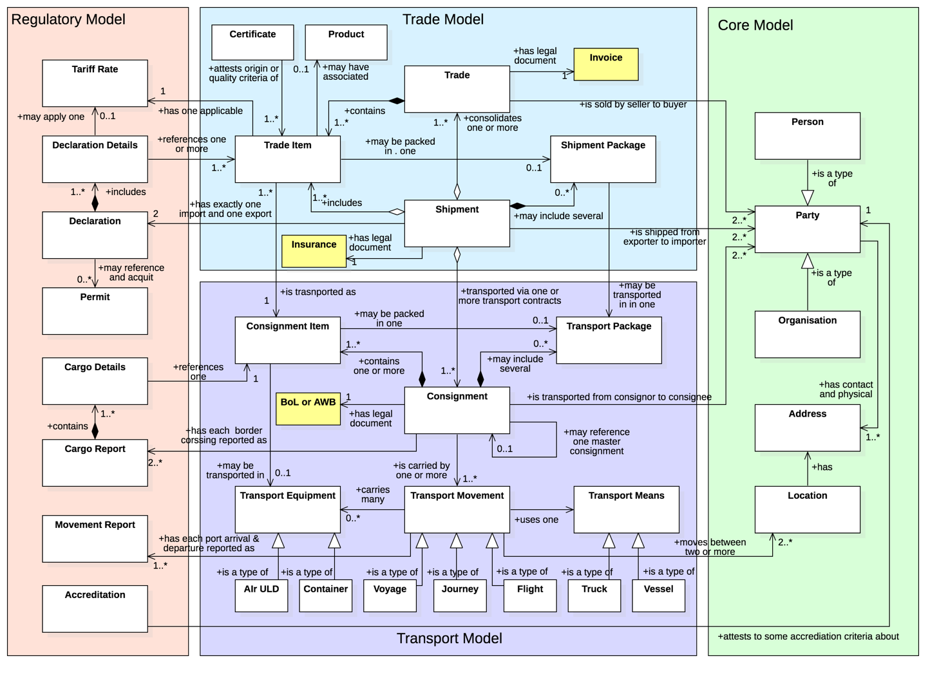
API Project is underway
To support all these initiative, AU Government is building a suite of APIs that will improve on (and eventually replace) the EDIFACT gateway. The approach is strongly based on UN/CEFACT Trade & Transport industry domain models.
Declarations are shipments with a duty calculation
Cargo reports are essentially just way bills.
Movements reports are just T&L movements
More on this in my final presentation today.

Slide 10
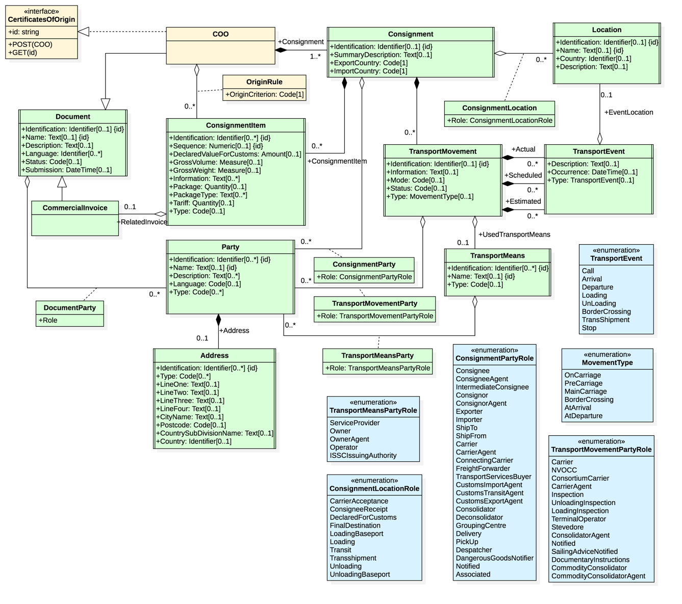
For example – the CoO data model
Is nothing more than an assertion about the origin criteria of a consignment item
In the linked data API world, the CoO is basically just a claim (origin criteria) about an identity (consignment item)

Slide 11
Thanks for listening
Feel free to contact me
Steve.capell@gmail.com
edi3.org

